Slide 1
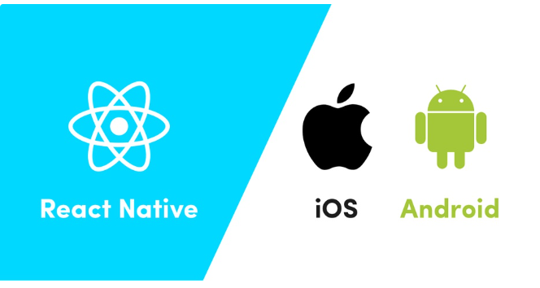
React Native

Slide 2
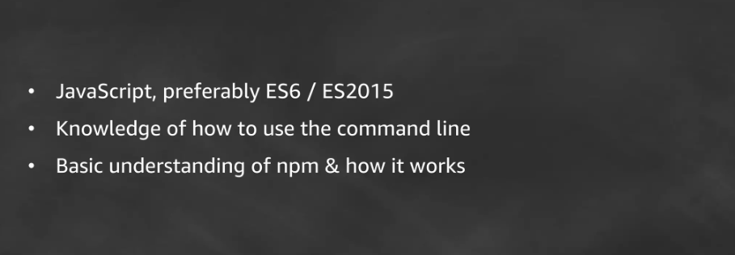
Prerequisites

Slide 3
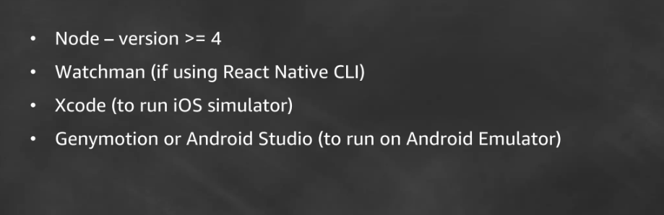
Environment

Slide 4
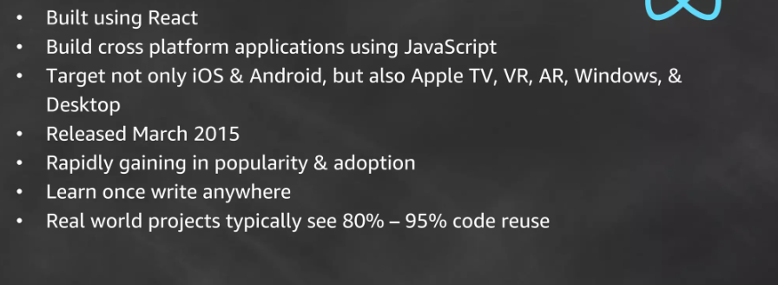
What is React Native ?

Slide 5
Who is using React Native
Thousands of apps are using React Native, from established Fortune 500 companies to hot new startups. If you are curious to see what can be accomplished with React Native, check out these apps!
https://reactnative.dev/showcase

Slide 6
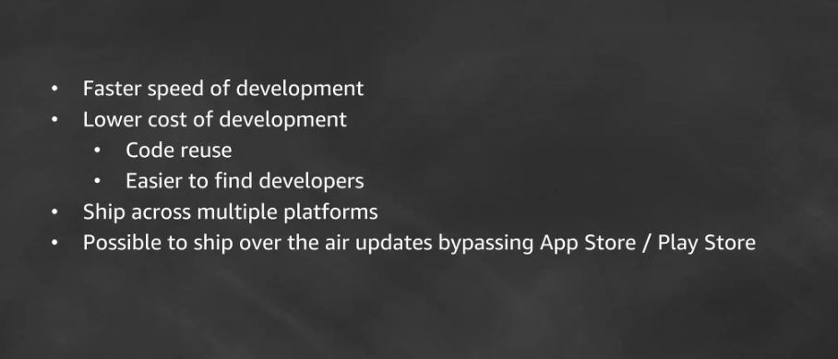
Why is React Native?

Slide 7
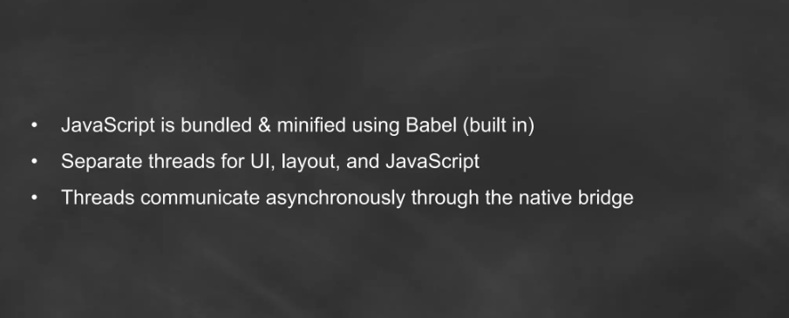
How does React Native work?

Slide 8
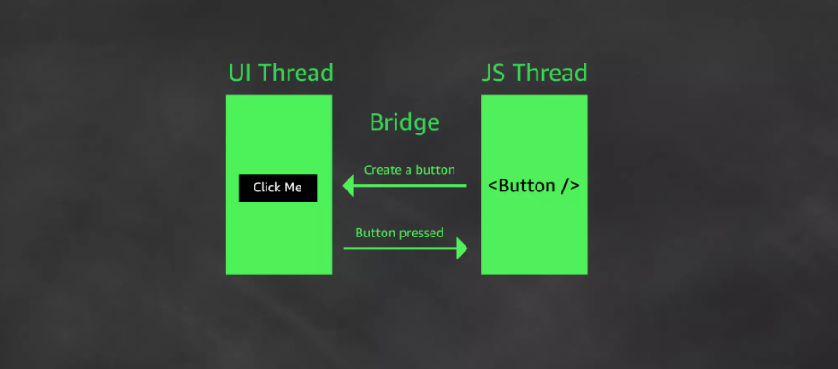
How does React Native work?

Slide 9

React Native API

Slide 10
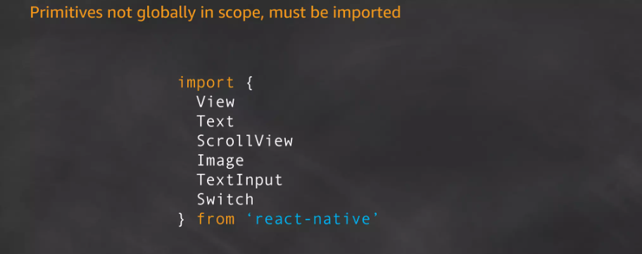
React Native API

Slide 11

React Native API

Slide 12
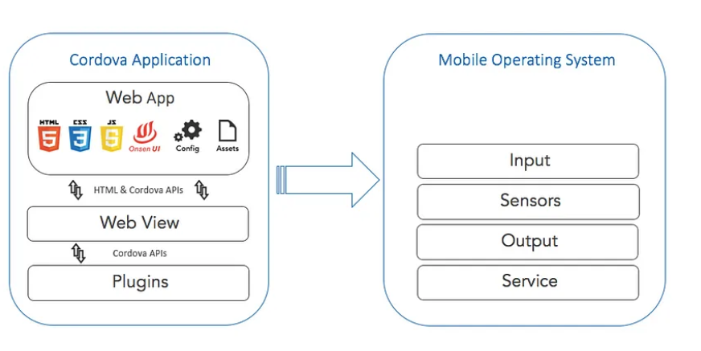
React native Vs Cordova

Slide 13

Thank You!!!

